Slide 1


Random Stuff
Dirk P. Kroese
School of Mathematics and Physics
The University of Queensland
Notes:
Introduction by Phil Pollett. Say something about ACEMS Thanks you Phil. Good evening everyone.
Like to give you a flavor of what we are doing in maths and stats when
dealing with random phenomena. Can see that centre is about mathematics by the integral sign.
This is supposed to be a non-technical talk.
For thousands of years people have been fascinated by randomness. Closely related to fate/destiny. Many religions have deities of chance.
Egyptians had a goddess of fate: Shai. Greek had Tyche. (Fortuna for the romans) goddess of luck (good/bad) and destiny.
Someone to explain your bad luck and someone elses good luck.
We are not born with a good intuition for randomness. Has to be learned by experience. To better understand randomness we can do experiments. Play bridge
long enough and you get an idea how likely certain hands are. Takes a long time.
Prediction audience size random experiment.

Slide 2
Outline
Randomness around us
How to make random numbers?
Monte Carlo methods for:
Simulation
Estimation
Optimisation
Notes:
Here is outline of the talk.
First .. examples of randomness around us
Second, how can we do this using computer? Computer is a very rigid device.
Here is outline of the talk.
First .. examples of randomness around us
Second, how can we do this using computer? Computer is a very rigid device.
Show you how these random numbers can be used for simulation, estimation, and optimisation.

Slide 3
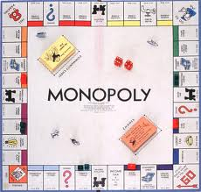
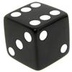
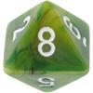
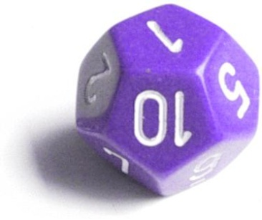
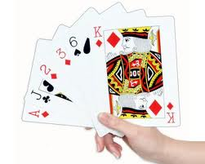
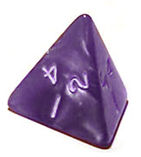
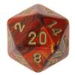
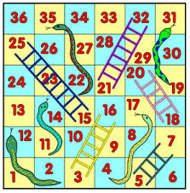
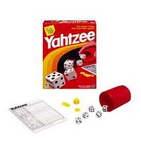
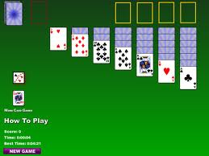
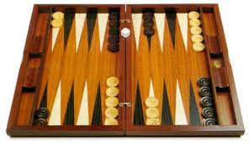
Games of Chance
Notes:
As humans we don't have good intuition for randomness. I guess that is why we are fascinated by games of chance.
Evidence that dice have been used for over 8000 years. Fortune telling.
Most interesting when there is a combination of skill/structure and randnmess. Backgammon.
As a matter of fact most people in my profession don't gamble, but the
challenge of decision making in the presence of randomness.

Slide 4
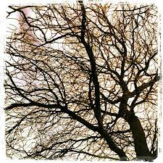
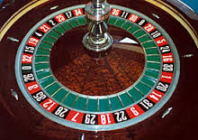
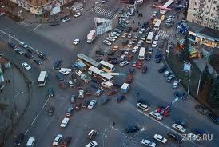
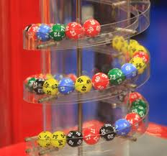
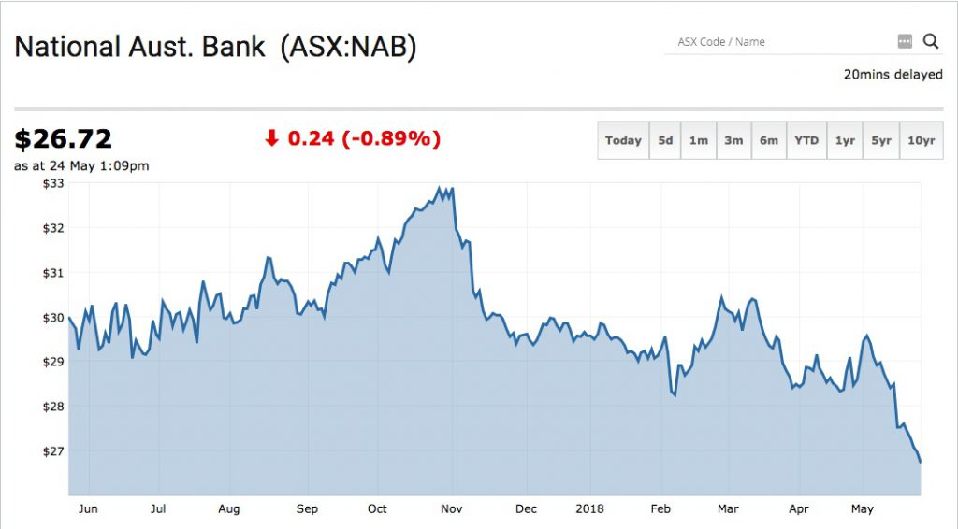
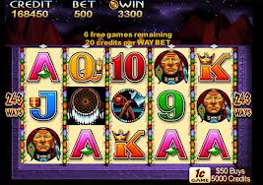
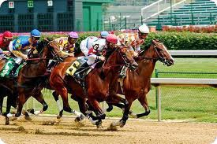
More Randomness
Notes:
Here is some randomness in real life. In trees for example there is a
random element and a systematic element in the growth.
Randomness in nature. Again combination of pattern and randomness.

Slide 5
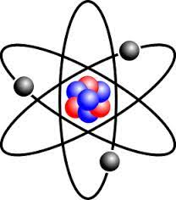
Randomness at its Deepest Level
We are such stuff as dreams are made on
And our little life is rounded with a sleep
William Shakespeare (The Tempest)
Notes:
When you think about it, at the deepest level we ourselves are random stuff as we are built up of atoms which are fundamentallyrandom. Described by probability theory.
I had to think of this quote by shakespear. We are such stuff.

Slide 6
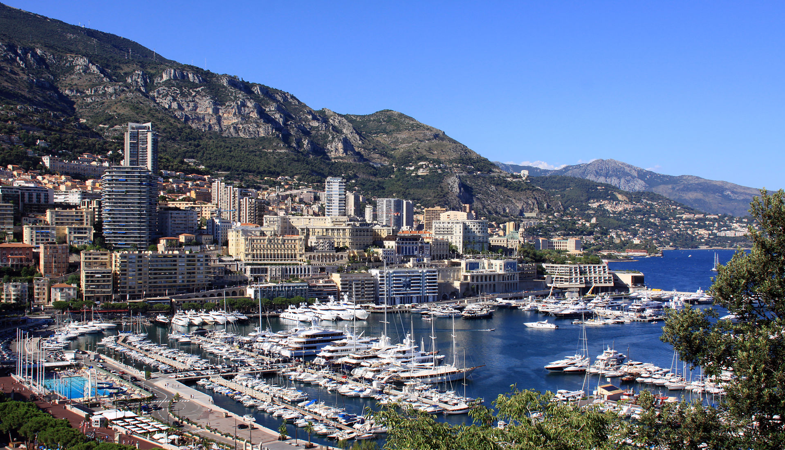
Monte Carlo (Monaco)
Notes:
Here is a nice place in Monaco (south of France) where the wealthy come to play. Lots of casinos and such.
The name was used the late 40's for a secret project to simulate (on an analog computer) the fission of atoms. Part of manhattan project.

Slide 7
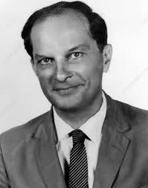

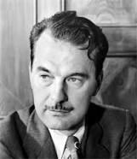
Monte Carlo Method
Stanislav Ulam
John von Neumann
Nicholas Metropolis
Notes:
In early 50's based Monte Carlo on digital computers such as MANIAC (mathematical and numerical integrator and calculator)
involving the work of John von Neumann (who relied on work by Alan Turing) Institute for Advanced Studies at Princeton
It became clear that is was useful to generate random numbers on a computer.

Slide 8
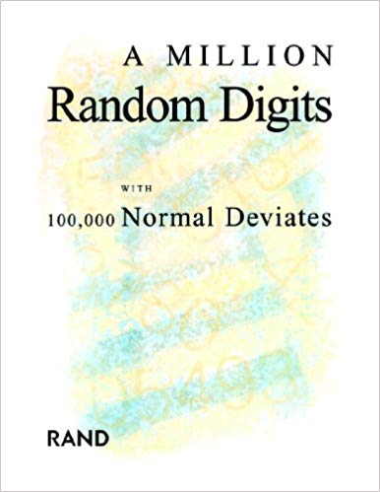
Notes:
Around the same time 1955 this book was produced. It is still in print as a cult object.
It contains just this 1 million random digits and . You should read the reviews. here are some.

Slide 9
A Million Random Digits"? HA!
They only used 10, and just kept repeating them in different combinations!
Don't be fooled!

Slide 10
Engrossing
A very engrossing book with historical importance, it keeps you guessing until the end.

Slide 11
Predictable
It seemed like about 10% of the time I was able to predict which number was next.
It was still better than Life of Pi which, aside from
being irrational, included no estimations of Pi at all!

Slide 12
Almost perfect
Such a terrific reference work! But with so many terrific random digits, it's a shame they didn't sort them, to make it easier to find the one you're looking for.

Slide 13
Pretty good but needs some fixes for the next edition
This is a very thorough tome and I found myself unexpectedly enjoying the numbers. However the reason I'm giving the book 4 stars is that it's very difficult to find your way back to a number you had previously enjoyed.
The RAND Corporation and/or the publisher really need to add an index so you can quickly refer your way back to those highlights that so wonderfully brightened up the day.

Slide 14
Shocked and appalled
Those Deviates were in no way normal. This is a shocking display of what our country as a whole has come to. When I was a kid, we had standard deviates and we liked it.

Slide 15
Normal deviates? I don't think so, pal.
Speaking as a normal deviate myself, I have to say this book is all wrong. I can't believe any real deviates were involved in researching it. What kind of weirdo has a fetish for numbers? More latex, less LaTeX, guys.

Slide 16
Wait for the movies …
I was thumbing through this in a book store…long enough to enjoy but certainly not long enough to *really* get the plot. Should I buy it or not?
Then a book store employee happened to mention that Peter Jackson was being approached to split the story into 3 parts and create a film trilogy based on the book. Enough said! This story is going to be MUCH better with some smoke and other visual effects. I can't wait until summer 2019!

Slide 17
Too advanced for me …
I bought this in the hope that I would be able to sit down on a rainy Sunday afternoon and look through it, and with each passing page, feel a sense of achievement.
However, for the life of me, I have been unable to find Waldo on any single page yet!
Someone, please give me some hints!

Slide 18
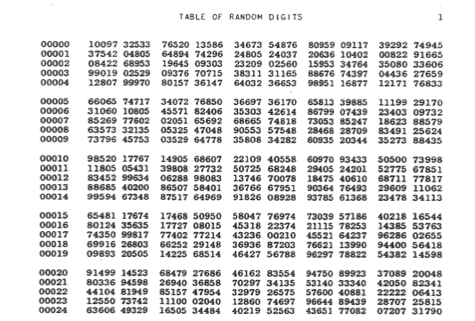

Notes:
table of random digits. has someone spotted Waldo yet?
If I have time I can discuss how they were generated.

Slide 19
Generating Random Numbers
Anyone who attempts to generate random numbers by deterministic means is, of course, living in a state of sin.
John von Neumann
The numbers in OMRD were obtained electro-mechanically (pulse generator + punch machine).
Nowadays random numbers are generated on a computer via simple mathematical formulas.

Slide 20
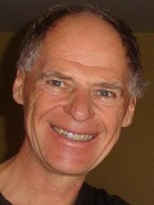
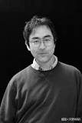
Pierre L’Ecuyer
mrg32k3a
Makoto Matsumoto
Mersenne Twister
Notes:
here are two people who have developed very good random number generators. Who is the best at marketing?

Slide 21
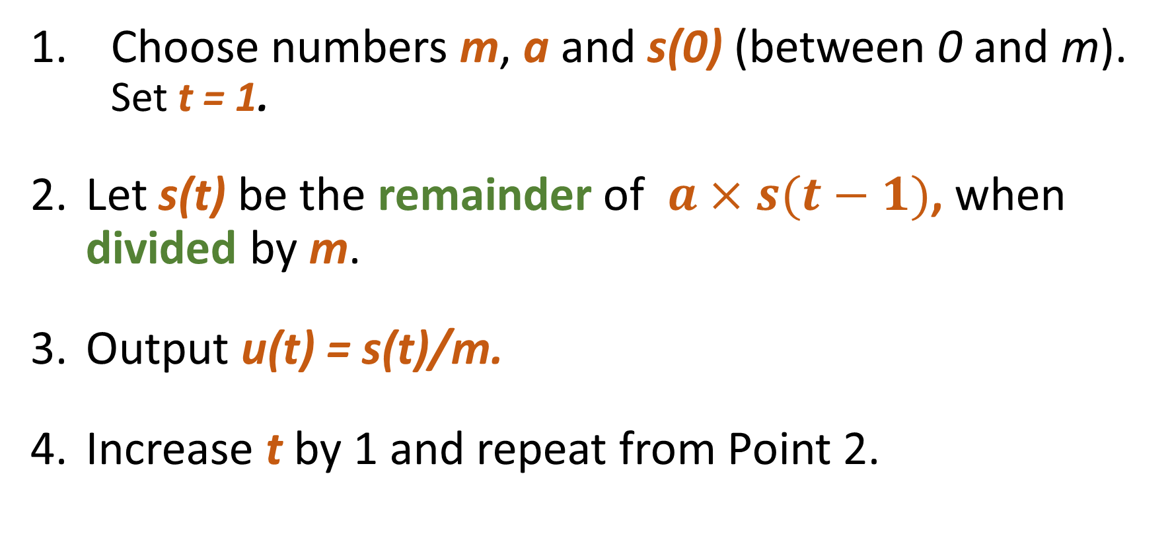
Basic Random Number Generator
Choose numbers m, a and s(0) (between 0 and m). Set t = 1.
Let s(t) be the remainder of $a×s(t−1)$, when divided by m.
Output u(t) = s(t)/m.
Increase t by 1 and repeat from Point 2.
Notes:
to give you an idea how random numbers are made, here is a basic algorithm.
20-25 minutes in

Slide 22
Example
m = 7, a = 3, s(0) = 1, produces:
s(1) = 3
s(2) = 2
s(3) = 6
s(4) = 4
s(4) = 5
s(5) = 1
s(6) = 3,…
Good choice:
m = 2^(31) – 1 = 2147483647
a = 7^5 = 16807
Notes:
Could do rng notebook if too fast

Slide 23
What can we do with Random Numbers?
Simulate: carry out random experiments
Estimate: calculate numbers using random experiments
Optimise: search using random processes
Notes:
What can we do with random numbers.
E.g. simulate 10 coin flip experiments with OMRD
he first line of OMRD gives TTHHTTHTT
We can also use this to divide a group of 20 people into two groups.

Slide 24
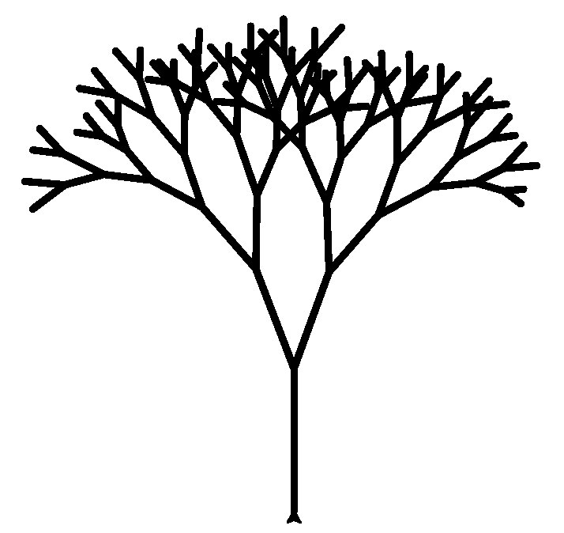
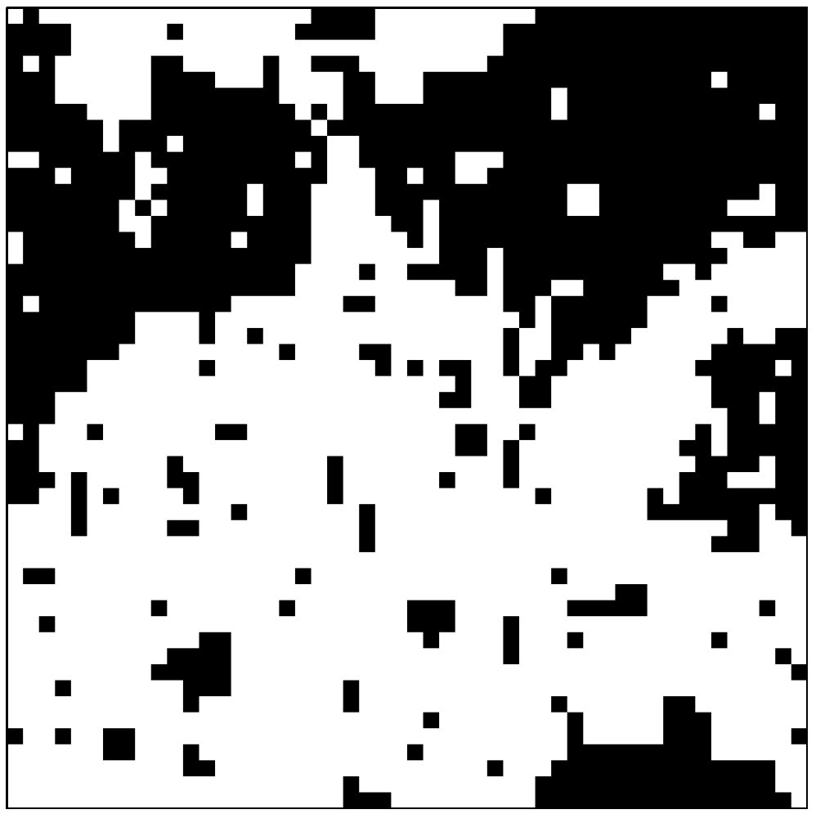
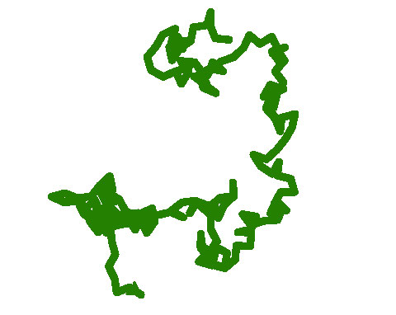
Some Random Process Simulations
Notes:
Random tree. Frangipani. Turtle on lawn. Ant random walk. Ferromagnetism in statistical mechanics. Property of atom called spin that can be in one of two states.

Slide 25
Monte Carlo Simulation
How can we simulate 10 coin flips?
Use the rand function (firstrand.ipynb).
Simulate a 2-D random walk (turtle.ipynb)
Simulate a tree (tree.ipynb)
Notes:
Python. Guido van Rossum. CWI. Python refers to Monty Phython. Download anaconda (python/anaconda). Free. Put it on website.

Slide 26
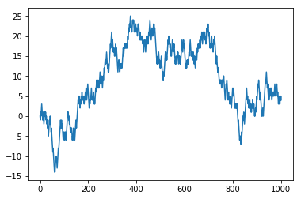
Share Price: a Random Walk?
randwalk.ipynb
Notes:
Random walk.. One dimenson. Only up and down. But also plot time.
Financial experts/commentator always find a reason why price goes up or down. Our new Tyche’s.
Sometimes same reason.
Price goes up because interest rate on hold or interest rate drop.
Let’s try. No idea what to expect.
Trump has made silly remark. Trump had made silly remark, but market had anticipated this.

Slide 27
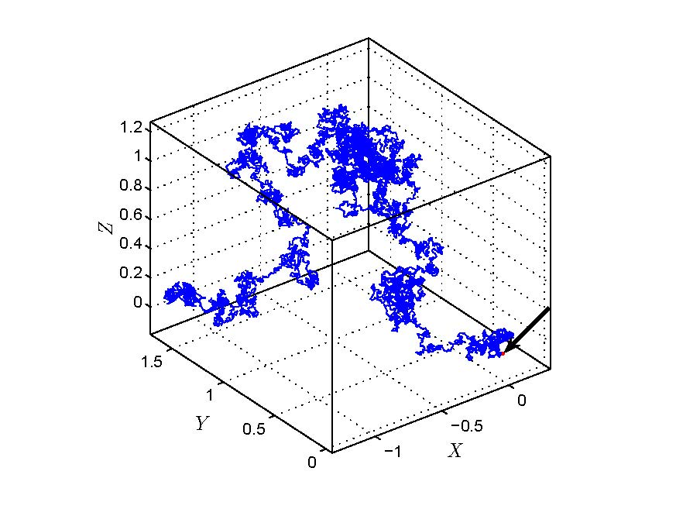
Simulating Brownian Motion
Notes:
1827 Robert Brown. Naturalist.

Slide 28
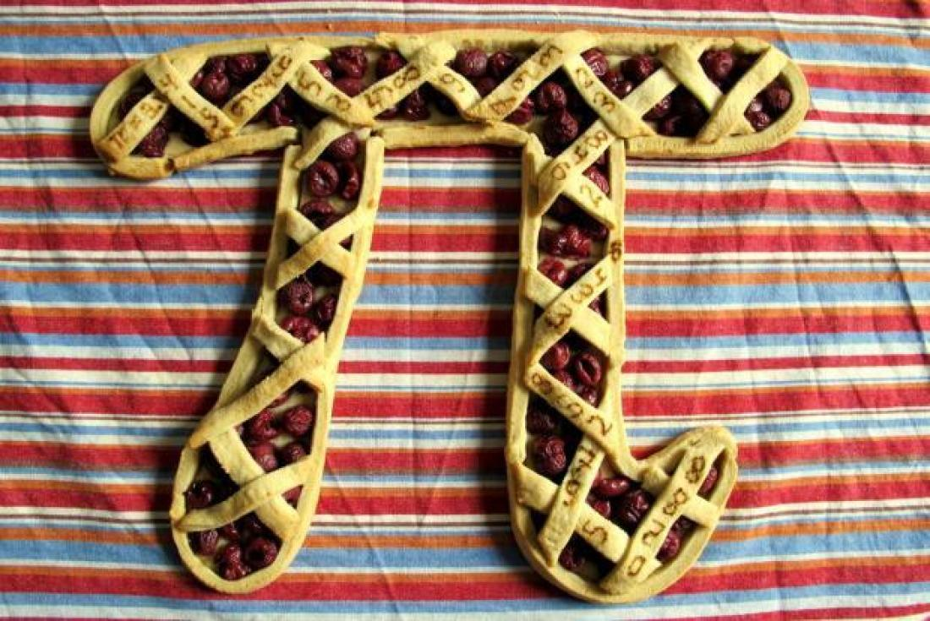
Monte Carlo for Estimation: Evaluating Pi
Notes:
Estimation of pi.

Slide 29
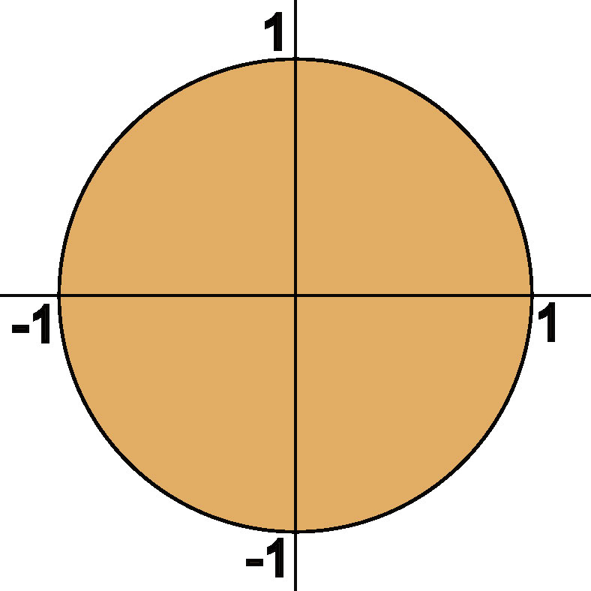
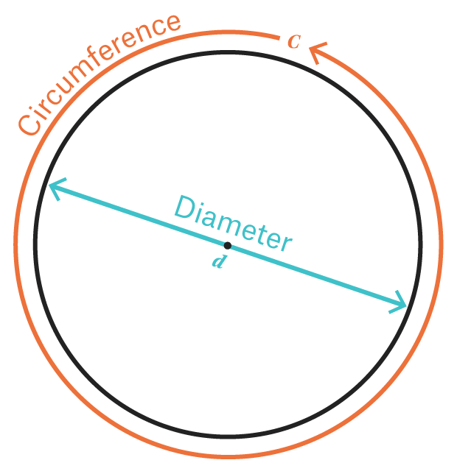
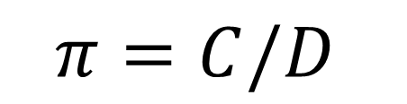
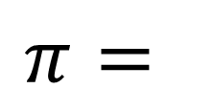

Two Definitions/Properties of
$$π$$
$$π=C/D$$
$$π=$$
Area of Unit Disk
Notes:
Think of pi in different ways.
mathematicians have always been facinated by pi

Slide 30
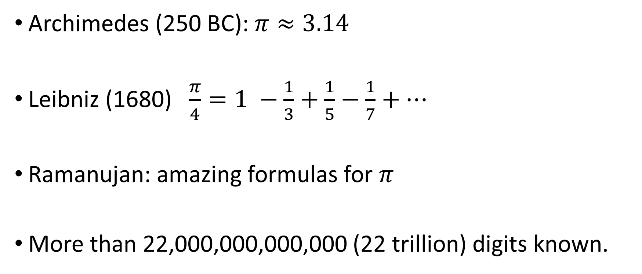

Calculating
$$π$$
Archimedes (250 BC): $π≈3.14$
Leibniz (1680) $\frac{π}{4}=1 −\frac{1}{3}+\frac{1}{5}−\frac{1}{7}+…$
Ramanujan: amazing formulas for $π$
More than 22,000,000,000,000 (22 trillion) digits known.

Slide 31
Indiana Pi Bill (1897)
Edwin Goodwin thought he had “squared the circle”
As a by-product he deduced that Pi = 3.2 (exactly!)
A Bill was introduced in House of Representatives to legislate this value for Pi. The bill was passed without a dissenting vote.
In the Senate, it nearly passed. However, the bill was postponed indefinitely, with the help of:
Clarence Abiathar Waldo
Notes:
I have a picture of him

Slide 33
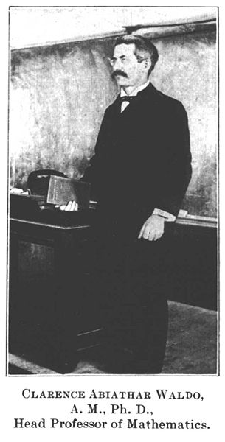

Slide 34
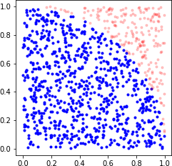
Estimating Pi with Monte Carlo
simulatepi.ipynb
Notes:
Idea of estimating pi. simulate uniformly a point in 0,1. That is draw to uniform numbers between 0,1. check if they point lies
inside the circle with radius 1. do this many times and ..
turn off plotting

Slide 35
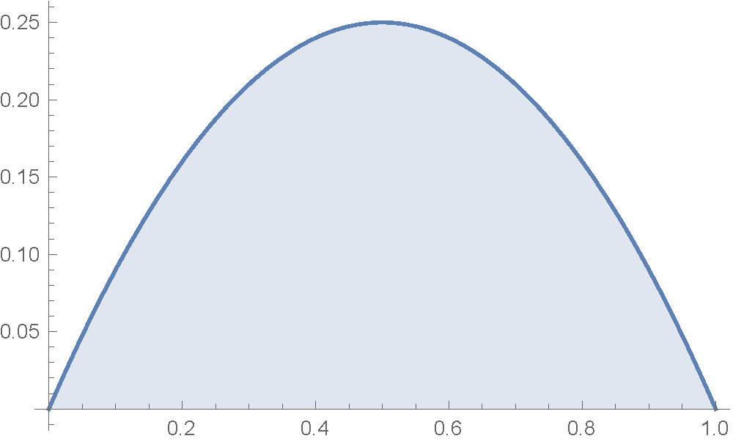
Evaluating Areas/Volumes/Integrals
Area under x(1-x)
mcint.ipynb
Notes:
evaluating integrals. area under this curve.

Slide 36
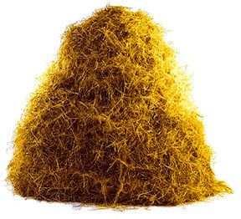
Monte Carlo for Searching and Counting
Notes:
We can use MC for searching for a needle in a mathematical haystack. And also for counting the number of needles.

Slide 37
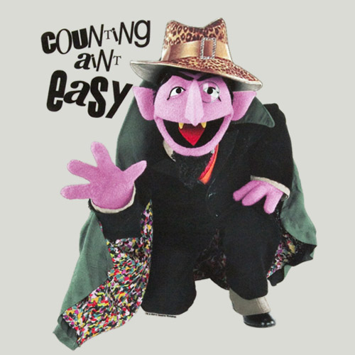
Counting Complicated Objects
Notes:
This is picture that I sometimes show the 8-year old, but the count always says that counting is easy. It’s not realy.
Whole branch of mathematics devoted to counting complicated objects. Combinatorics.

Slide 38
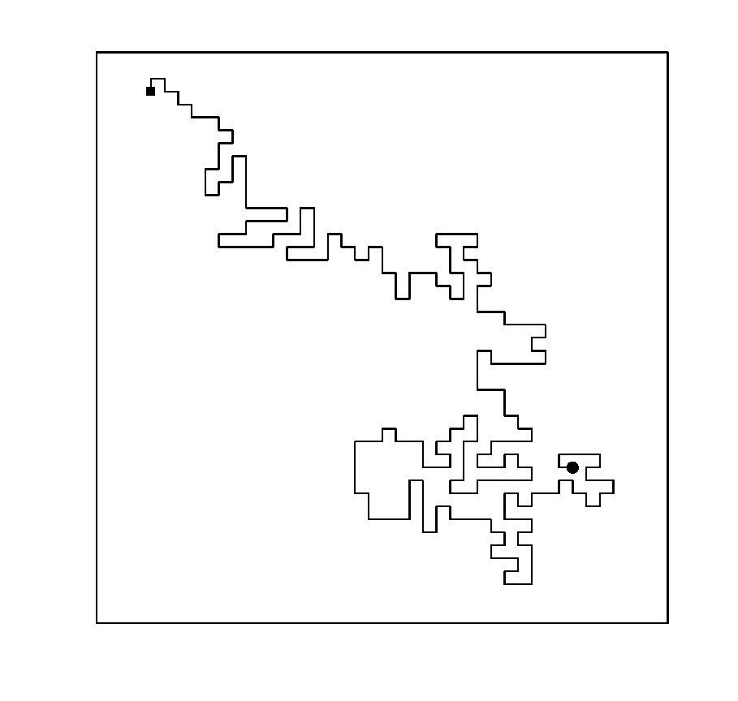
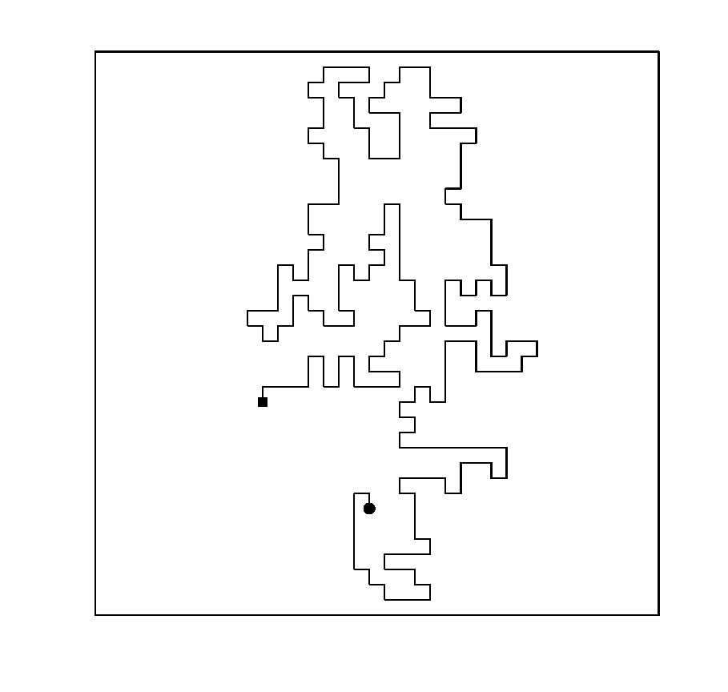
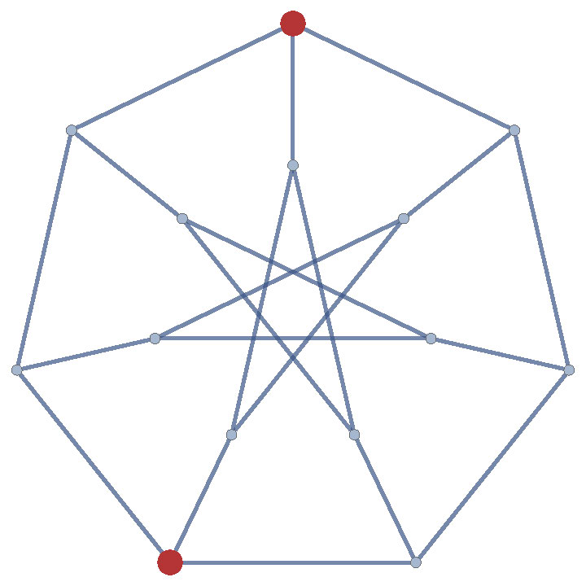
How Many Paths?

Slide 39
Idea for Counting
Suppose the “special” objects all lie in a larger set for which we know the number of elements exactly, say N.
Randomly select n objects from the larger set.
Count how many are special, say s.
Then we estimate the number of special objects as N s/n
Notes:
Idea for counting similar to estimating pi. average value.

Slide 40
Idea for Counting
The previous method is very inefficient when the number of special objects is very small compared to N.
More sophisticated methods are then required.

Slide 41
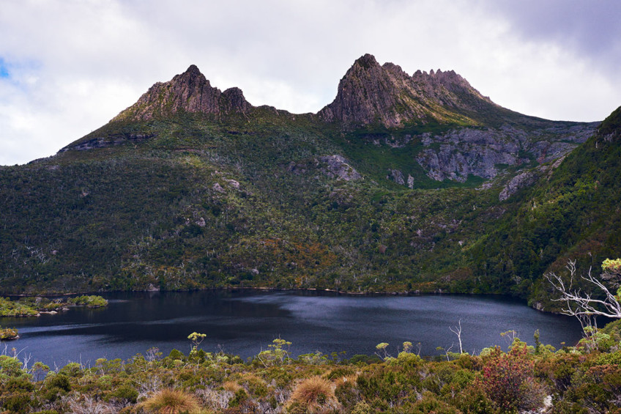
Monte Carlo for Optimisation
Notes:
Optimization is like searching for the best value. Eg. Highest point on cradle mountain. Easy to see here, but in high dimensions
***10/20 minutes to go.**

Slide 42
Idea for Optimisation
Simulate many points on the search space according to a random mechanism
Take the best performing points
Update the random mechanism based on the best performing points
Repeat until the search “degenerates” to one point
Notes:
Of course the crucial points are what the random mech is and how the updating works.

Slide 43
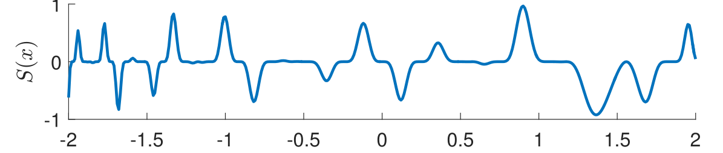
Minimize this function
Notes:
Suppose we want to find the minimum of this function. Many troughs and peaks. Randomly select point and evaluate. Take best. Not good strategy.

Slide 44
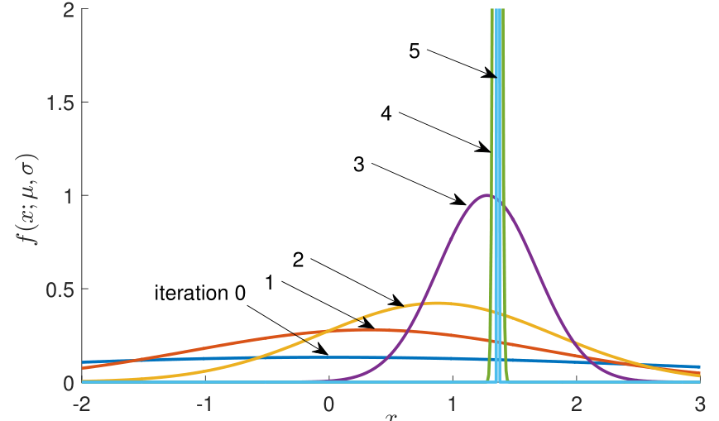
Evolution of the Cross-Entropy Algorithm
Notes:
Curve indicates how likely it is that we sample a point there.

Slide 45
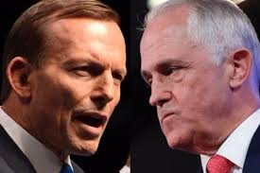
How to Split a Group
Notes:
Can optimize in quite general search spaces. Same idea

Slide 46

How to Split a Group Optimally

Slide 47

1. Randomly split the group in two, using biased coins
2. Do this many times
3. Select the few best
4. Update the coins, based on the best ones found.
5. Repeat

Slide 48
Example
Split a group of 400 people
There are 2^400 possible groups; that is:
2582249878086908589655919172003011874329705792829223512830659356540647622016841194629645353280137831435903171972747493376
Take 400 coins; start with Heads probabilities all 0.5
Flip a coin for person 1,…,400 to put into Heads or Tails group.
Do this 1000 times, take the best 100, update the coins

Slide 49

Evolution of the coin biases. Step 1

Slide 50

Evolution of the coin biases. Step 2

Slide 51

Evolution of the coin biases. Step 3

Slide 52

Evolution of the coin biases. Step 4

Slide 53

Evolution of the coin biases. Step 5

Slide 54

Evolution of the coin biases. Step 6

Slide 55

Evolution of the coin biases. Step 7

Slide 56

Evolution of the coin biases. Step 8

Slide 57

Evolution of the coin biases. Step 9

Slide 58

Evolution of the coin biases. Step 10

Slide 59

Evolution of the coin biases. Step 11

Slide 60

Evolution of the coin biases. Step 12

Slide 61

Evolution of the coin biases. Step 13

Slide 62

Evolution of the coin biases. Step 14

Slide 63

Evolution of the coin biases. Step 15

Slide 64

Evolution of the coin biases. Step 16

Slide 65

Evolution of the coin biases. Step 17

Slide 66

Evolution of the coin biases. Step 18

Slide 67

Evolution of the coin biases. Step 19

Slide 68
Evolution of the coin biases. Step 20

Slide 69

What is the best tour?
Notes:
Traveling salesman problem.

Slide 70
Similar idea for optimisation
Generate paths/tours randomly via some random procedure
Take the best (shortest) paths
Update the random procedure using the best tour, to produce “better” paths next time
Repeat until convergence

Slide 71

Best Tour

Slide 72

Finally …
Monte Carlo guidelines:
Set off in a random direction sometimes …
Diversity is crucial!
Determinism vs Free Will
Conditional random walk
Notes:
Exploration vs exploitation. Exploration is very important if you have complicated search space.
Laplace. Scientific determination. Boundary/initial conditions.
But what about free will. Raise right hand because of destiny or chance.
Maybe both can be true. Can understand via random walk model.

Slide 73

Notes:
3D brownian bridge or combination. Projection.

Slide 74



Coming soon!
Mathematical and Statistical Methods for
Data Science and Machine Learning
Dirk P. Kroese, Zdravko I. Botev,
Thomas Taimre, and Radislav Vaisman
Notes:
If you want to dive into this field and have some mathematical background, this is what many people are using.
You might also be interested in the coming book. CRC Press. Coming later this year.
Thank you for your attention and hope you get a slightly better idea why randomness is not an enemy that must be explained away, but can be very useful in many situations.

